Slide 1
Big Data Analytics and Mining

Slide 2
TextBook and More
Textbook
Mining of Massive Datasets
(Jure Leskovec, Anand Rajaraman, and U.)
[Sold by Cambridge Univ. Press, and available at www.mmds.org]
Reference Book
Data Mining： Concept and Techniques
(Jiawei Han, Micheline Kamber, and Jian Pei)
Online Open Courses
1）Mining of Massive Datasets
2）Machine Learning（Andrew Ng）

Slide 3
What will we talk?

Slide 4
Content
Introduction to Big Data Mining
Foundation of Data Mining
Hashing
Sampling
Data Stream Mining
Graph Mining
Hadoop-Spark

Slide 5
Prerequisites
Basic Algorithms
Probability and Statistic (Probability, Bayes, etc.)
Linear algebra (Matrix Theory)
Programming (Java/C++/Pathon, etc.)
Database systems (SQL, Relational database)

Slide 6

Classroom Expectations
Follow classroom rules
Try your best on every in-class activity, assignment, and test

Slide 7
Evaluation
Closed-book Final-term Examination

Slide 8
Lecture ONE
Introduction to Big Data Mining

Slide 9
What era do we live in NOW？

Slide 10


Slide 11
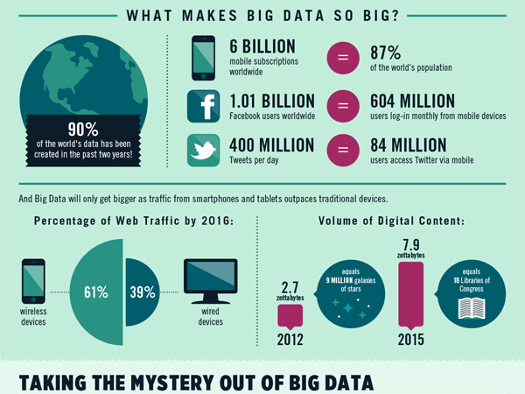

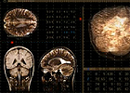
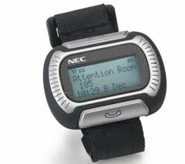
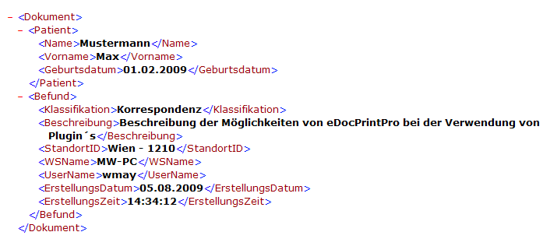
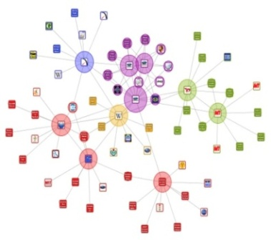
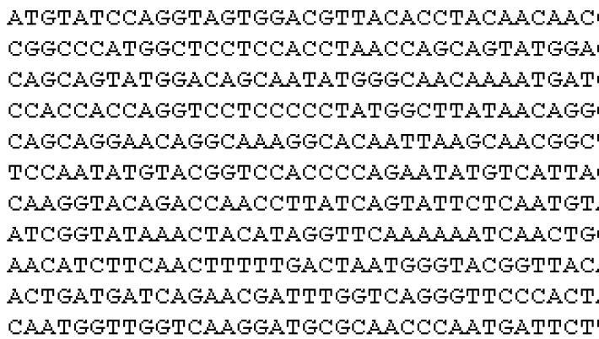



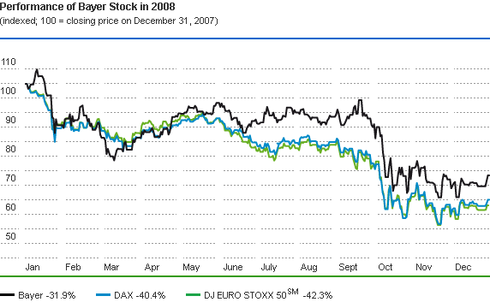
Media/Entertainmet
Healthcare
DNA
fMRI/ DTI
Messenger Watch
BIG DATA
Gene
Sequence
Industry
E-commerce
Sensor
Manufacture
Wall Mart: 2.5 PB/hour
Stock Data
*Note: some pictures derived from Internet

Slide 12

“Era of Big Data”
Examples
Flickr (3 billion photos)
YouTube (83M videos)
Web (10B videos watched / mo.)
Digital photos (500 billion / year)
All broadcast (70,000TB / year)
Yahoo! Webmap (3 trillion links, 300TB compressed, 5PB disk)
Human genome (2-30TB uncomp.)

Slide 13
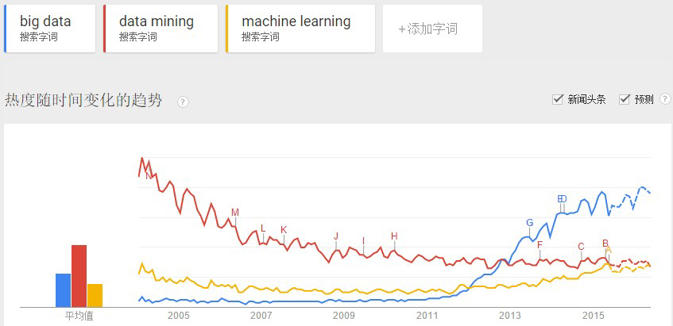
Big data popularity on the web

Slide 14
“Era of Big Data” – WHY?

Slide 15
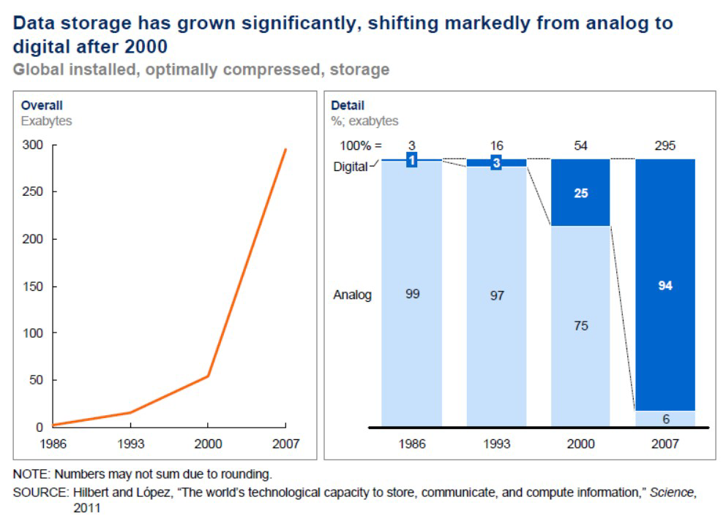
Enabler：Data storage

Slide 16
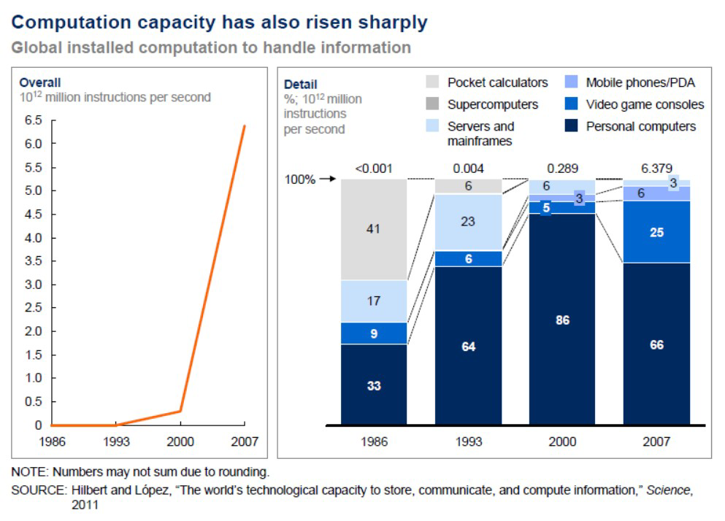
Enabler：Computation Power

Slide 17
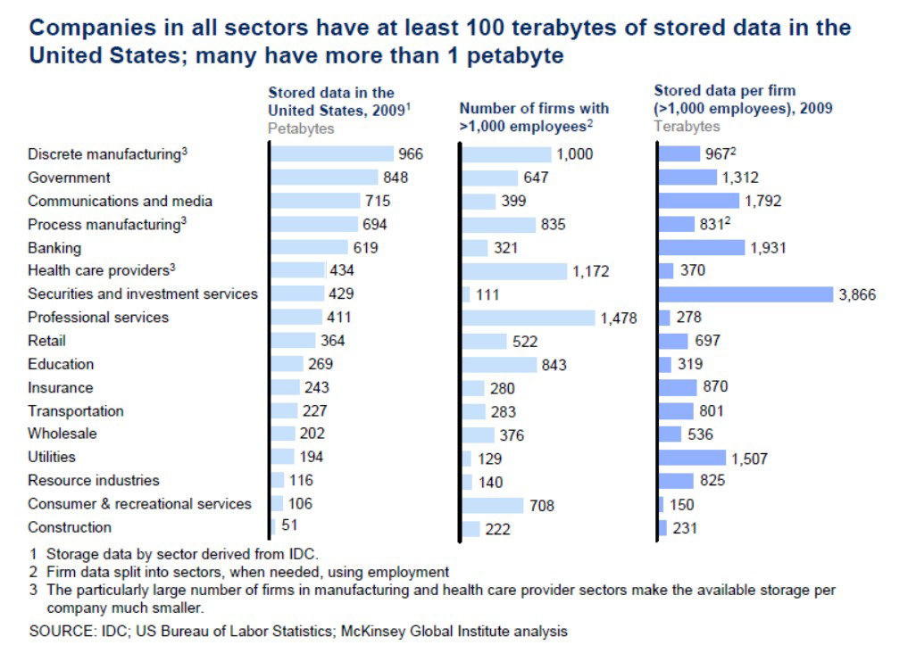
Enabler：Data availability

Slide 18



Data available from social networks and mobile devices
Mobile devices
(tracking all objects all the time)
Social media and networks
(all of us are generating data)

Slide 19


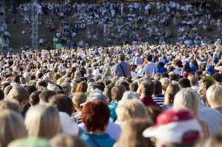

The Model Has Changed…
The Model of Generating/Consuming Data has Changed
Old Model: Few companies are generating data, all others are consuming data
New Model: all of us are generating data, and all of us are consuming data

Slide 20
WHAT IS BIG DATA？
What can we derive from big data?

Slide 21
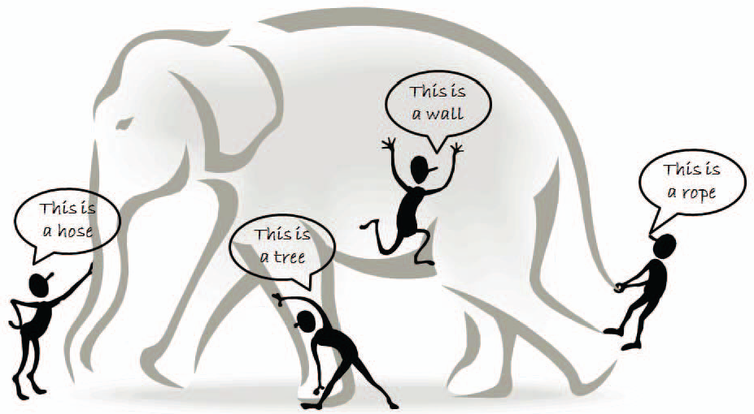
BIG DATA: What It Is
Big data is a buzzword, or catch-phrase, used to describe a massive volume of both structured and unstructured data that is so large that it's difficult to process using traditional database and software techniques. (IDC white paper, 2011)
Small data vs. Big data
Xingdong Wu et al., IEEE TKDE 2014

Slide 22
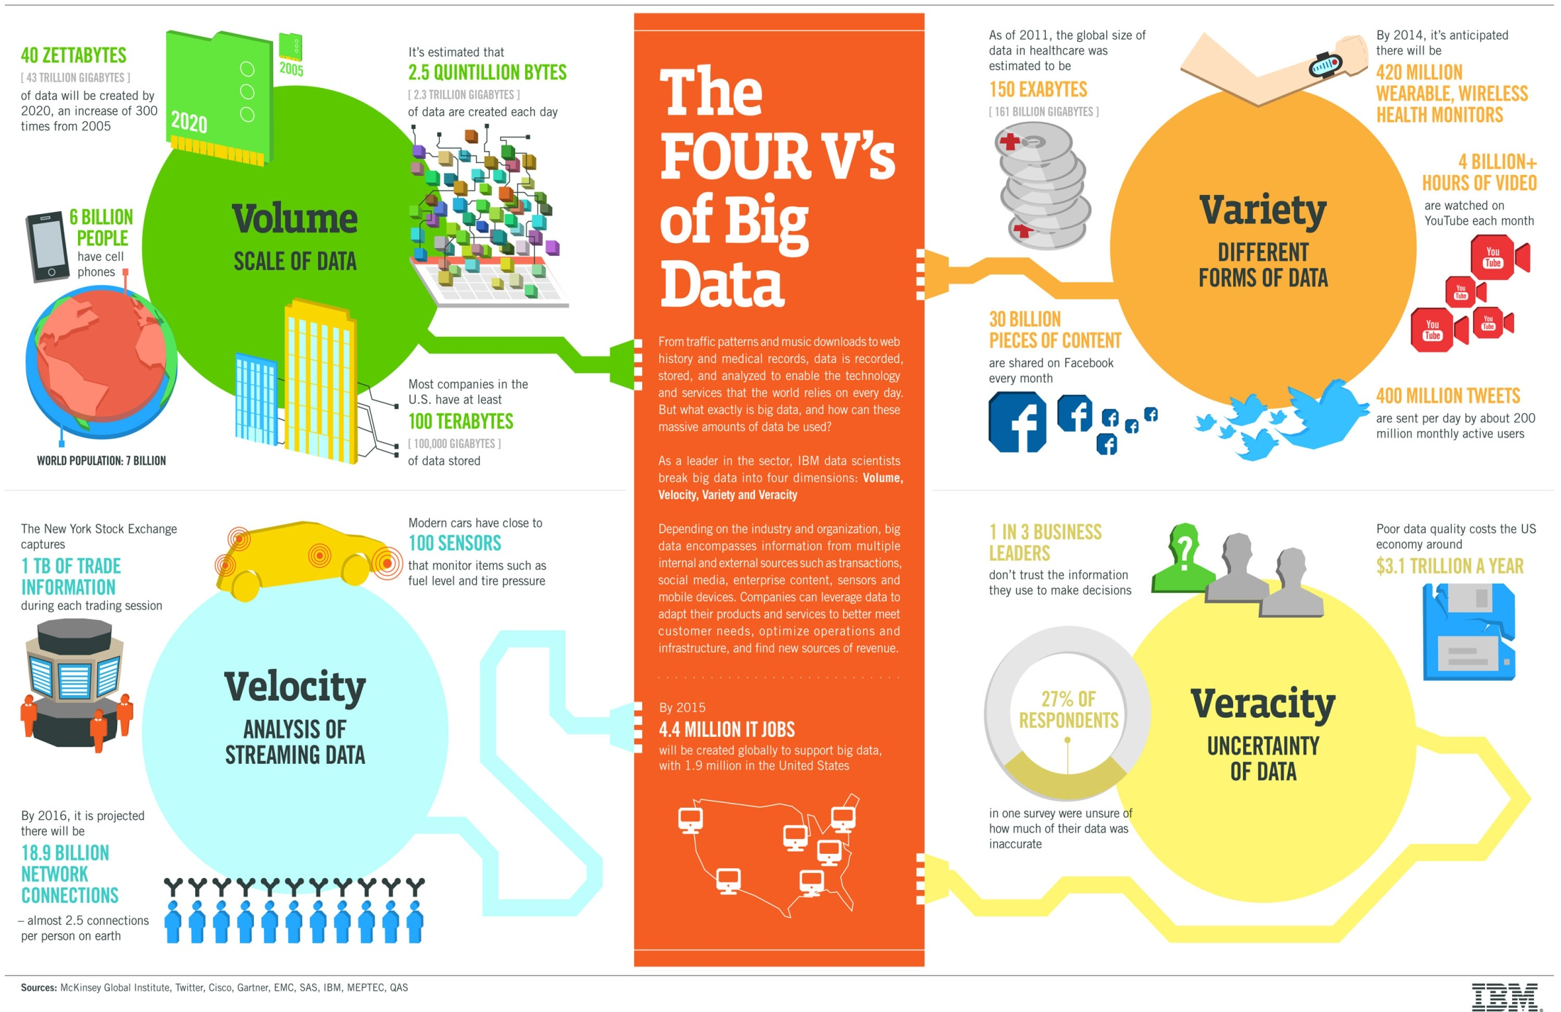
FEATURES－The FOUR V’s of BIG DATA

Slide 23
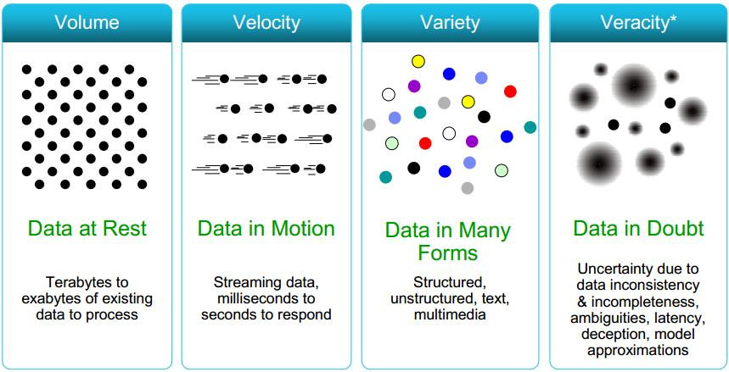
Some Make it 4V’s

Slide 24
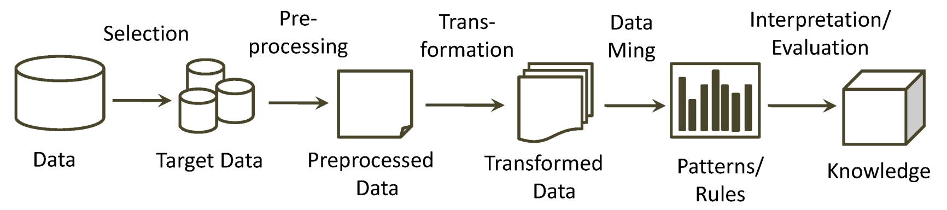
Data Mining
How to automatically understand and analyze these increasing amount of data effectively and efficiently ?
Knowledge Discovery in Databases (KDD)
Data mining consists of applying data analysis and discovery algorithms that, under acceptable computational efficiency limitations, produce a particular enumeration of patterns over the data [Fayyad et al.,1996].

Slide 25
History of Data Mining
1989 IJCAI Workshop on Knowledge Discovery in Databases
Knowledge Discovery in Databases (G. Piatetsky-Shapiro and W. Frawley, 1991)
1991-1994 Workshops on Knowledge Discovery in Databases
Advances in Knowledge Discovery and Data Mining (U. Fayyad, G. Piatetsky-Shapiro, P. Smyth, and R. Uthurusamy, 1996)
1995-1998 International Conferences on Knowledge Discovery in Databases and Data Mining (KDD’95-98)
Journal of Data Mining and Knowledge Discovery (1997)
ACM SIGKDD conferences since 1998 and SIGKDD Explorations
More conferences on data mining
PAKDD (1997), PKDD (1997), SIAM-Data Mining (2001), (IEEE) ICDM (2001), etc.
ACM Transactions on KDD starting in 2007

Slide 26
Potential Applications
WHAT DATA MINING CAN DO FOR US?

Slide 27
Market Analysis and Management
Target marketing
Find clusters of “model” customers who share the same characteristics: interest, income level, spending habits, etc.
Determine customer purchasing patterns over time
Cross-market analysis —Find associations/co-relations between product sales, & predict based on such association
Customer profiling—What types of customers buy what products (clustering or classification)
Customer requirement analysis
Identify the best products for different groups of customers
Predict what factors will attract new customer

Slide 28
Corporate Analysis & Risk Management
Finance planning and asset evaluation
cash flow analysis and prediction
contingent claim analysis to evaluate assets
cross-sectional and time series analysis (financial-ratio, trend analysis, etc.)
Resource planning
summarize and compare the resources and spending
Competition
monitor competitors and market directions
group customers into classes and a class-based pricing procedure
set pricing strategy in a highly competitive market

Slide 29
Fraud Detection & Mining Unusual Patterns
Auto insurance: ring of collisions
Money laundering: suspicious monetary transactions
Medical insurance
Professional patients, ring of doctors, and ring of references
Unnecessary or correlated screening tests
Telecommunications: phone-call fraud
Phone call model: destination of the call, duration, time of day or week. Analyze patterns that deviate from an expected norm
Retail industry
Analysts estimate that 38% of retail shrink is due to dishonest employees

Slide 30

Example——Flu Prediction
Google engineers published a paper in the famous "Nature" science journal. Identify 45 key words of flu and put them in a mathematical model. The predictions are in line with the official published facts and, like the CDC.
The judgment is very timely and effective.

Slide 31
Example——Telecom
BT releases a new product that needs to be recommended to its customers via direct mail.
The Reponses of direct mails improves 100％。

Slide 32
Example——Retail
GUS retailers need to accurately predict future product sales to reduce inventory costs.
Data mining methods reduce inventory costs more than 3.8% original cost.

Slide 33

Example——Bank
HSBC needs to classify its growing customers and find the most valuable customer for each product.
Marketing expenses decreased by 30%.

Slide 34
Main Data Mining Tasks

Slide 35
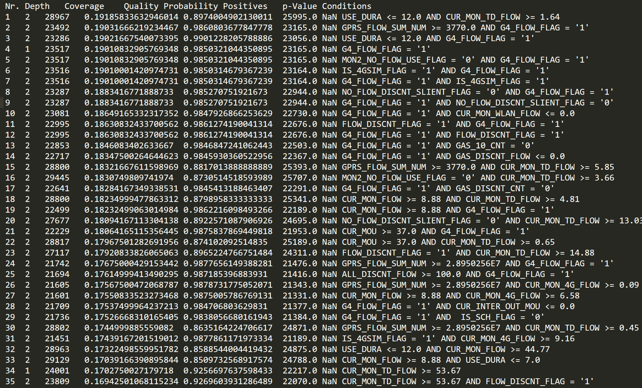
1. Association Rule Mining: 4G transfer analysis

Slide 36
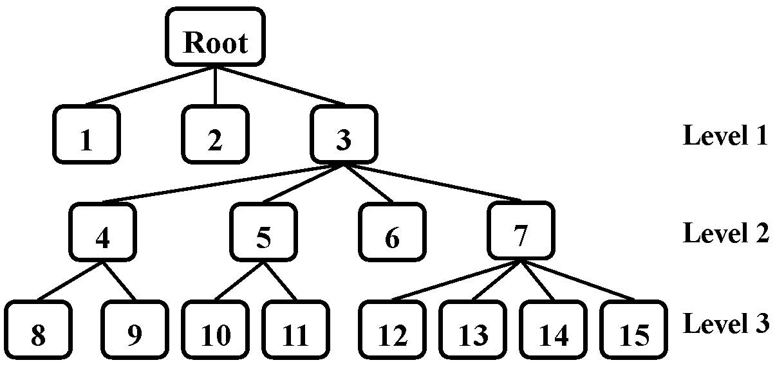
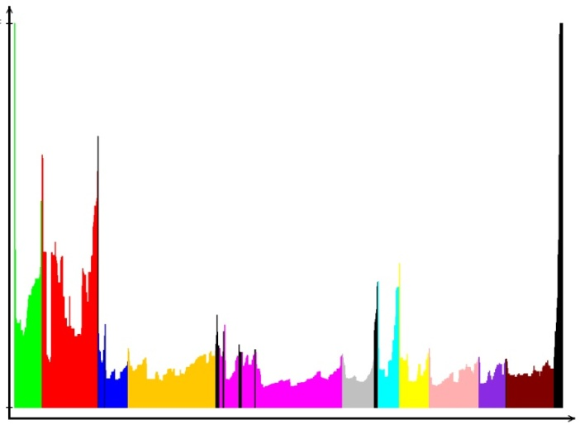
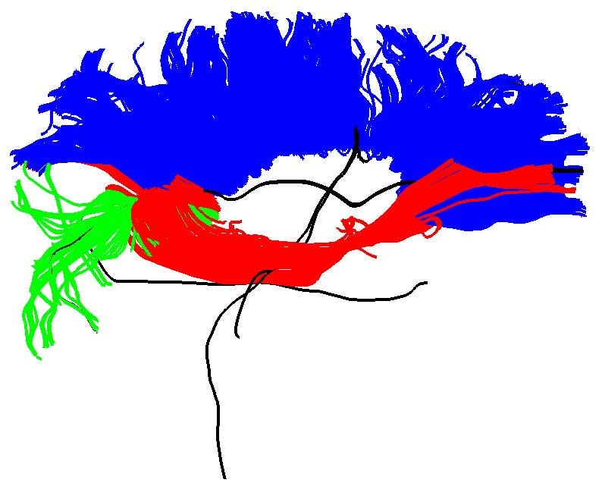
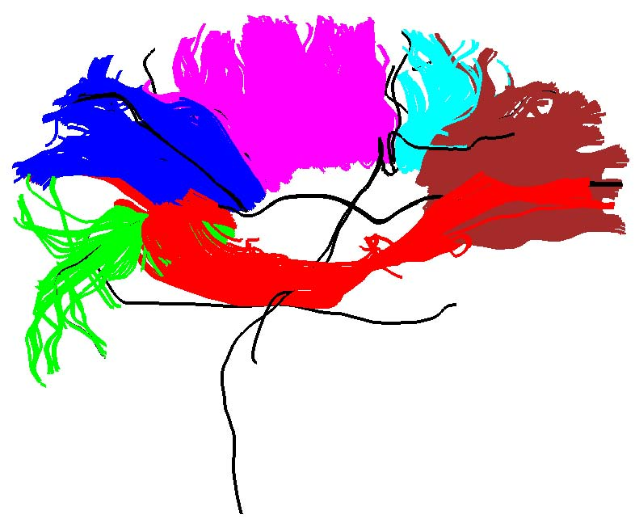

2. Cluster Analysis: Fiber clustering
Fiber Clustering
(a) Fiber density plot (b) Hierarchical tree
(c) Level 1 (d) Level 2 (e) Level 3

Slide 37






(f) Level1（noise） (g) Level2（noise） (h) Level3（noise）

Slide 38
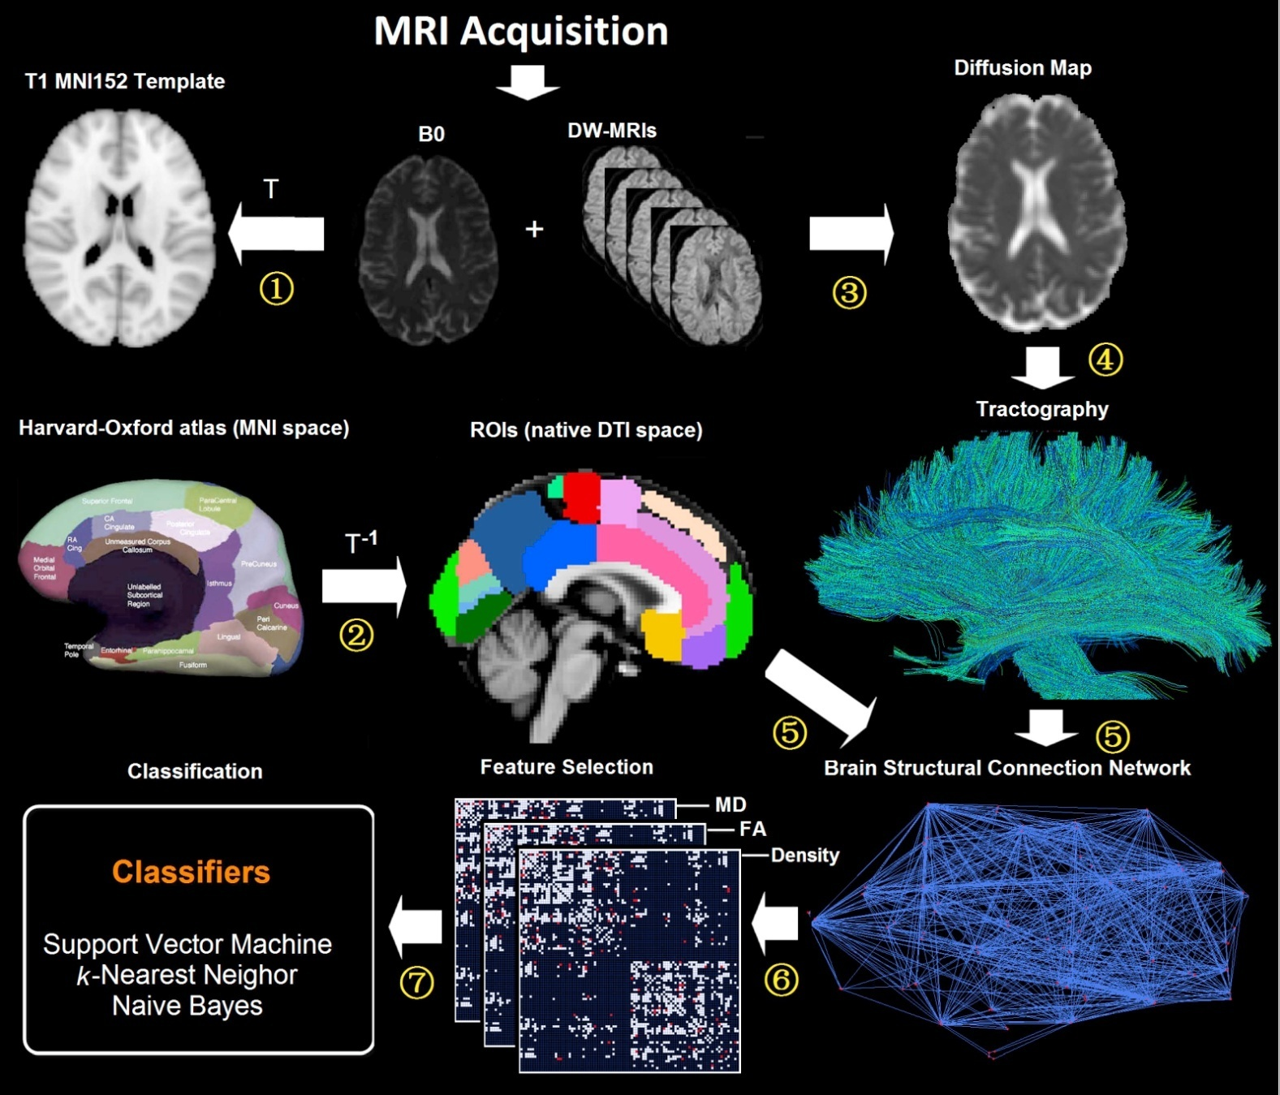
3. Classification/Prediction: AD Prediction

Slide 39
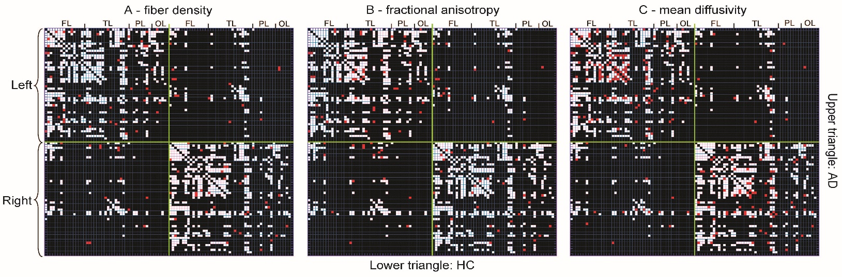
Feature Selection
Classification Performance
 | SVM | k-NN | Naive Bayes
AD vs. HC
Density | 100.0% | 94.74% | 100.0%
FA | 92.11% | 94.74% | 100.0%
MD | 100.0% | 94.74% | 89.47%
AD vs. pAD
Density | 85.00% | 85.00% | 95.00%
FA | 82.50% | 75.00% | 85.00%
MD | 85.00% | 82.50% | 90.00%
pAD vs. HC
Density | 97.73% | 81.82% | 95.45%
FA | 84.09% | 88.64% | 97.73%
MD | 93.18% | 86.36% | 100.0%

Slide 40
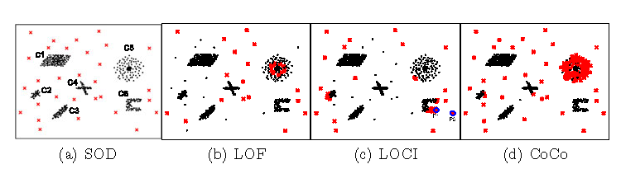
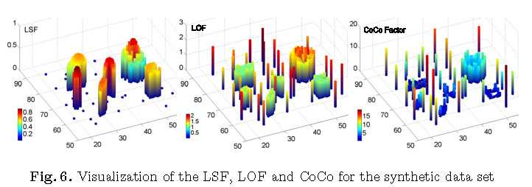
4. Outlier Detection: NBA players analysis

Slide 41
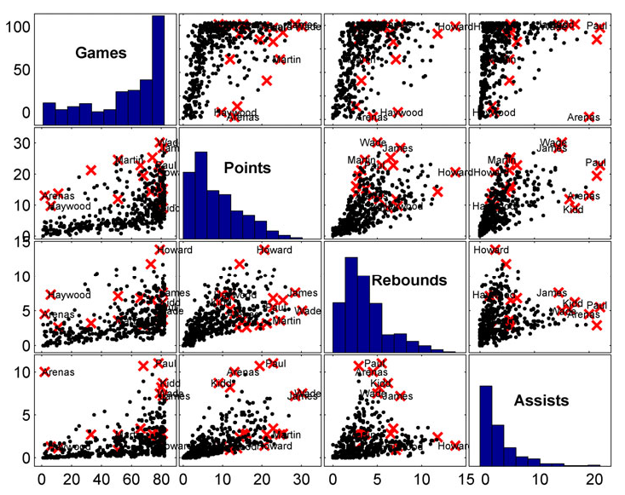
Example 1: NBA球员分析

Slide 42
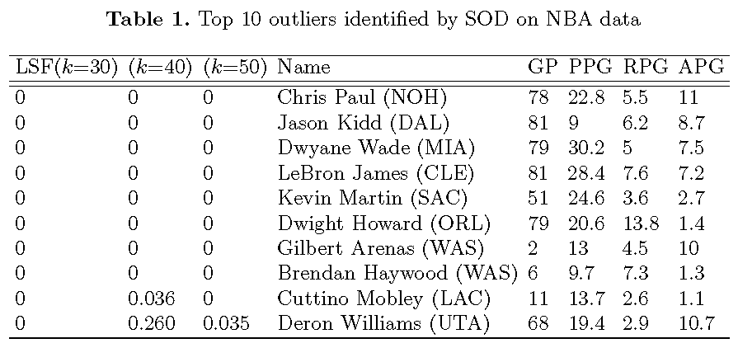

Slide 43
Main Directions of Big Data Mining

Slide 44
Volume (Scale of Data) :
Scalable Data Mining Algorithms
Basic idea: propose new data mining algorithms to handle big data using differernt strategies, mainly focus on:
Novel scalable algorithms (Sampling, Hashing, Divide-and-Conquer, etc.)
Map-reduce oriented Parallell platforms (Hadoop, Spark, GraphLab)
Speed-up Hardwares (GPUs/Clouds/Clusters)

Slide 45
Velocity (Data Stream) :
Data Stream Mining
Basic idea: propose new data mining algorithms to handle evloving data streams using differernt strategies, mainly focus on:
Handle Evolving Data Streams
Clustering on Massive Data Streams
Classification/Prediction
Semi-supervised Learning
Irregular nodes/patterns mining on data streams

Slide 46
Variety (Different format of data, different sources) :
Multi-source or multi-type data mining
Basic idea: propose new algorithms for structure or unstructure data, or different types of data, different sources, etc, mainly focus on:
Different types of data (E.g. categorical data, nominal data, mixed- type data mining )
Different forms of data (vector data, graph data, hetergeneous data)
Learning on different sources of data (Transfer learning, Multi-task learning, etc)
Mining Dynamic data (Clustering, LBS, ...)
Data fusion or data integration (multiple-kernel learning）

Slide 47
Veracity (Uncertainty, missing value) :
Uncertainty Analysis, Link/Missing value prediction,
Link Prediction (Clustering-based, Structure-based, Multi-view based)
Uncertain data Clustering (Probability-function based)
Recommender System (Missing items prediction,...)

Slide 48
Related Materials

Slide 49
Main Data Mining Conferences
ACM SIGKDD (A+), Feb.
IEEE ICDM (A), Jun.
SIAM SDM (A), Oct.
ECML/PKDD (A-), Apr.
PAKDD (B+), Oct.

Slide 50
Main Data Mining Journals
IEEE Transactions on Knowledge and Data Engineering (TKDE)
SIGKDD Explorations
ACM Transactions on Knowledge Discovery From Data (TKDD)
Data Mining and Knowledge Discovery
Knowledge and Information Systems (KIS)

Slide 51
Related Conferences
ACM SIGMOD(A+)
VLDB (A)
ICML/AAAI/NIPS
IEEE ICDE(A)
CIKM
WWW
CVPR/ICCV

Slide 52
Where to Find References?
Google, DBLP, CiteSeer
Data mining and KDD (SIGKDD: CDROM)
Conferences: ACM-SIGKDD, IEEE-ICDM, SIAM-DM, PKDD, PAKDD, etc.
Journal: Data Mining and Knowledge Discovery, KDD Explorations, ACM TKDD
Database systems (SIGMOD: ACM SIGMOD Anthology—CD ROM)
Conferences: ACM-SIGMOD, ACM-PODS, VLDB, IEEE-ICDE, EDBT, ICDT, DASFAA
Journals: IEEE-TKDE, ACM-TODS/TOIS, JIIS, J. ACM, VLDB J., Info. Sys., etc.
AI & Machine Learning
Conferences: Machine learning (ML), AAAI, IJCAI, COLT (Learning Theory), CVPR, NIPS, etc.
Journals: Machine Learning, Artificial Intelligence, Knowledge and Information Systems, IEEE-PAMI, etc.
Web and IR
Conferences: SIGIR, WWW, CIKM, etc.
Journals: WWW: Internet and Web Information Systems,
Statistics
Conferences: Joint Stat. Meeting, etc.
Journals: Annals of statistics, etc.
Visualization
Conference proceedings: CHI, ACM-SIGGraph, etc.
Journals: IEEE Trans. visualization and computer graphics, etc.

Slide 53
Take Home Message
What is BIG DATA?
The Features of Big Data (4V)
Data Mining and its Tasks
Main Directions of Big Data Mining
Top Conferences and Journals

Slide 54
Thanks !!!

